Slide 2
EA

Slide 3
T
EA
CH
教

Slide 4
ER

Slide 5
V. 動詞
+
er
=
做這個 V. 動詞的人
愛做這個 V. 動詞的人
做這個 V. 動詞的機器
做這個 V. 動詞的…

Slide 6
T
EA
CH
ER
老師，教師

Slide 7
EA

Slide 8
L
EA
D
vt.
引導；領（路）；走在（隊伍等）的最前頭
vi.
領路；通向，導致n.[C]
指導，榜樣；領先地位adj.
領先的；最重要的

Slide 9

What does she do?

Slide 10
She leads.

Slide 11
What is she doing?

Slide 12
She is leading.

Slide 13
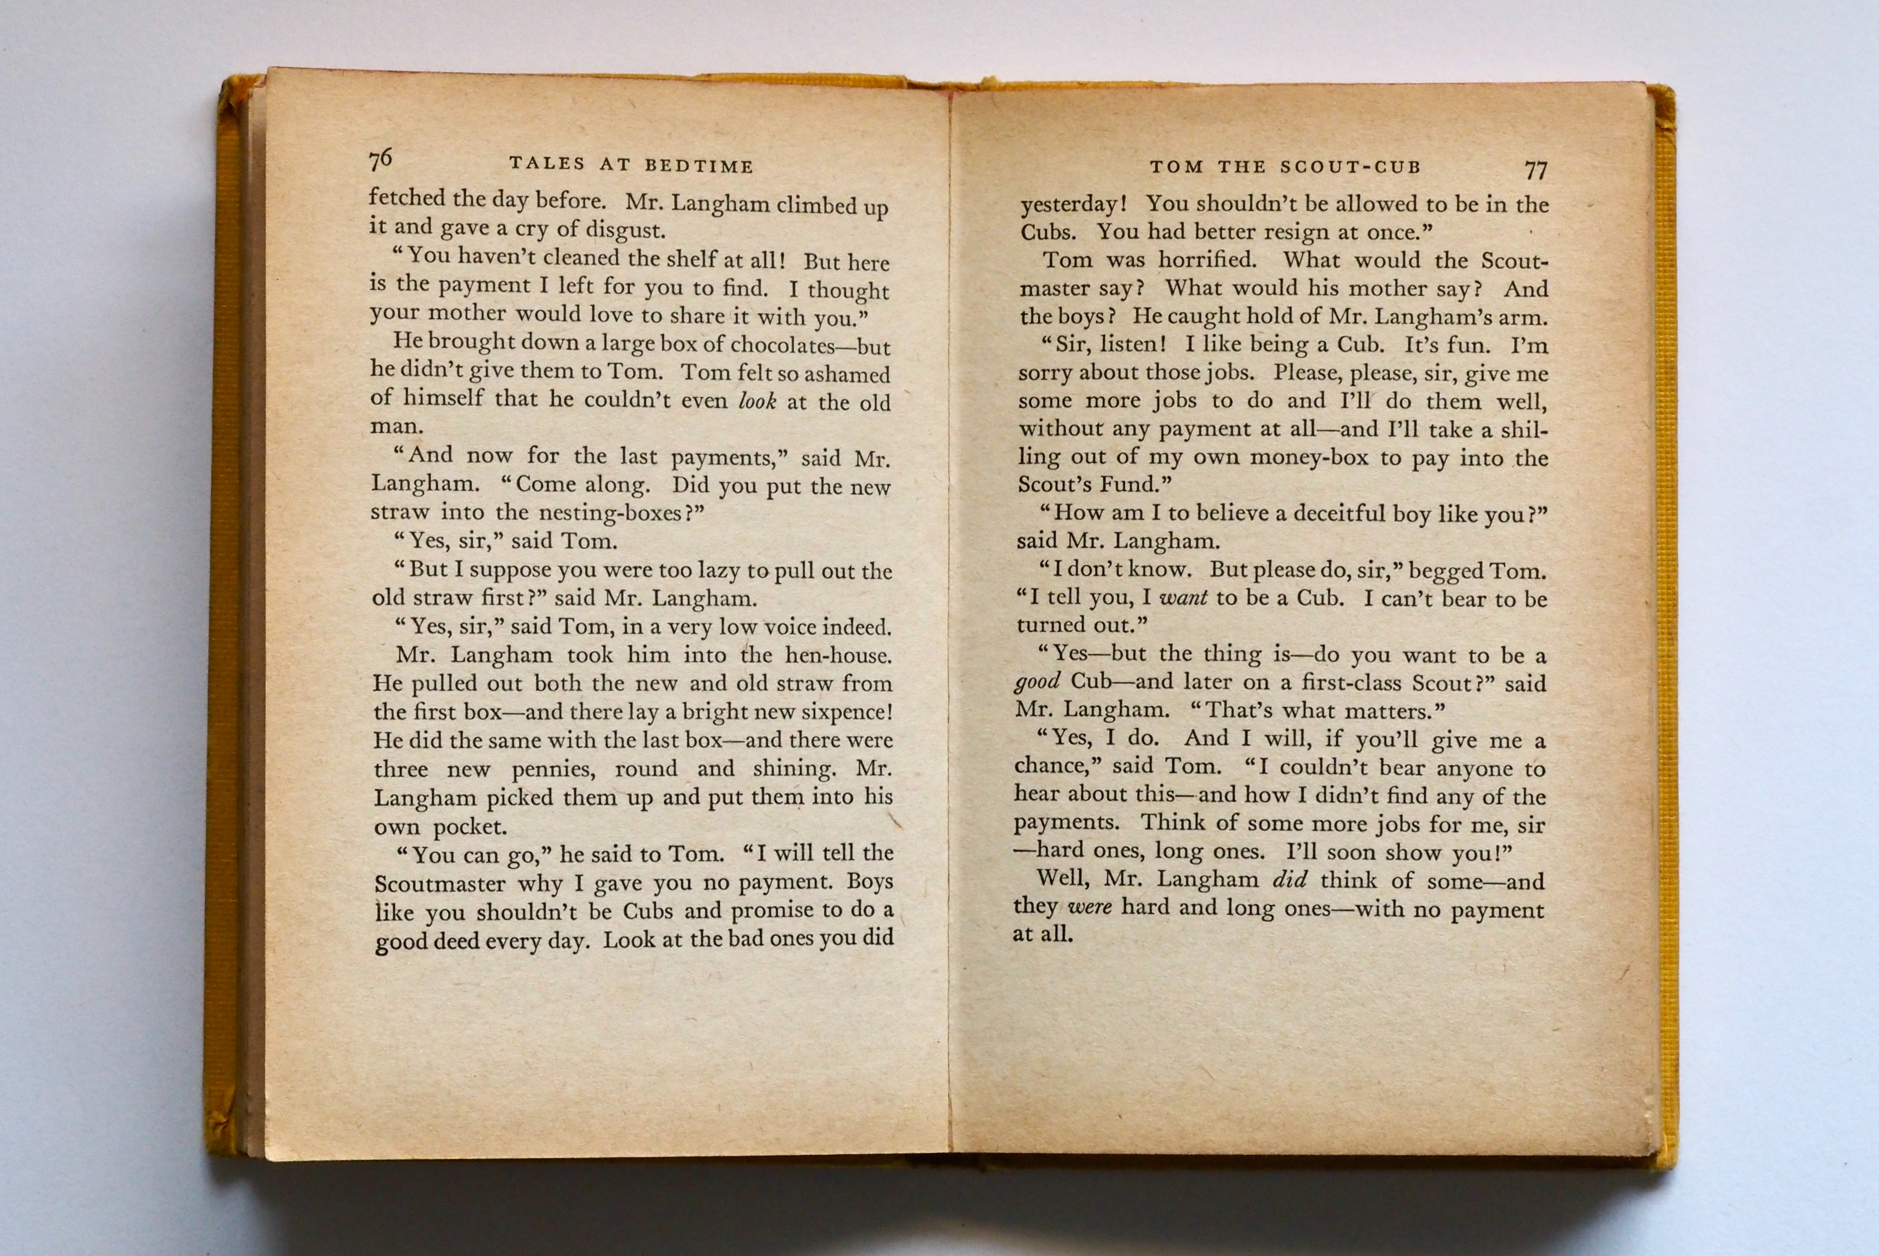

Slide 15

R
EA
D
a book

Slide 16


Slide 17

R
EA
D

Slide 18
V. 動詞
+
er
=
做這個 V. 動詞的人
愛做這個 V. 動詞的人
做這個 V. 動詞的機器
做這個 V. 動詞的…

Slide 19

It is a reader.

Slide 20

She is a reader.

Slide 21
L
EA
D
vt.
引導；領（路）；走在（隊伍等）的最前頭
vi.
領路；通向，導致n.[C]
指導，榜樣；領先地位adj.
領先的；最重要的

Slide 22
V. 動詞
+
er
=
做這個 V. 動詞的人
愛做這個 V. 動詞的人
做這個 V. 動詞的機器
做這個 V. 動詞的…

Slide 23
What is she?

Slide 24
l
e
a
e
r
She is a ______.
d

Slide 25

He is a leader.

Slide 26
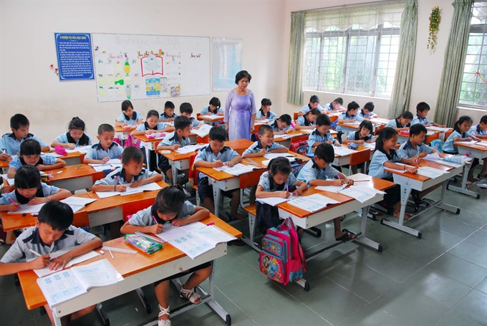
What is this?

Slide 27
This is a class?

Slide 28

What is he?

Slide 29
He is the class leader.

Slide 30
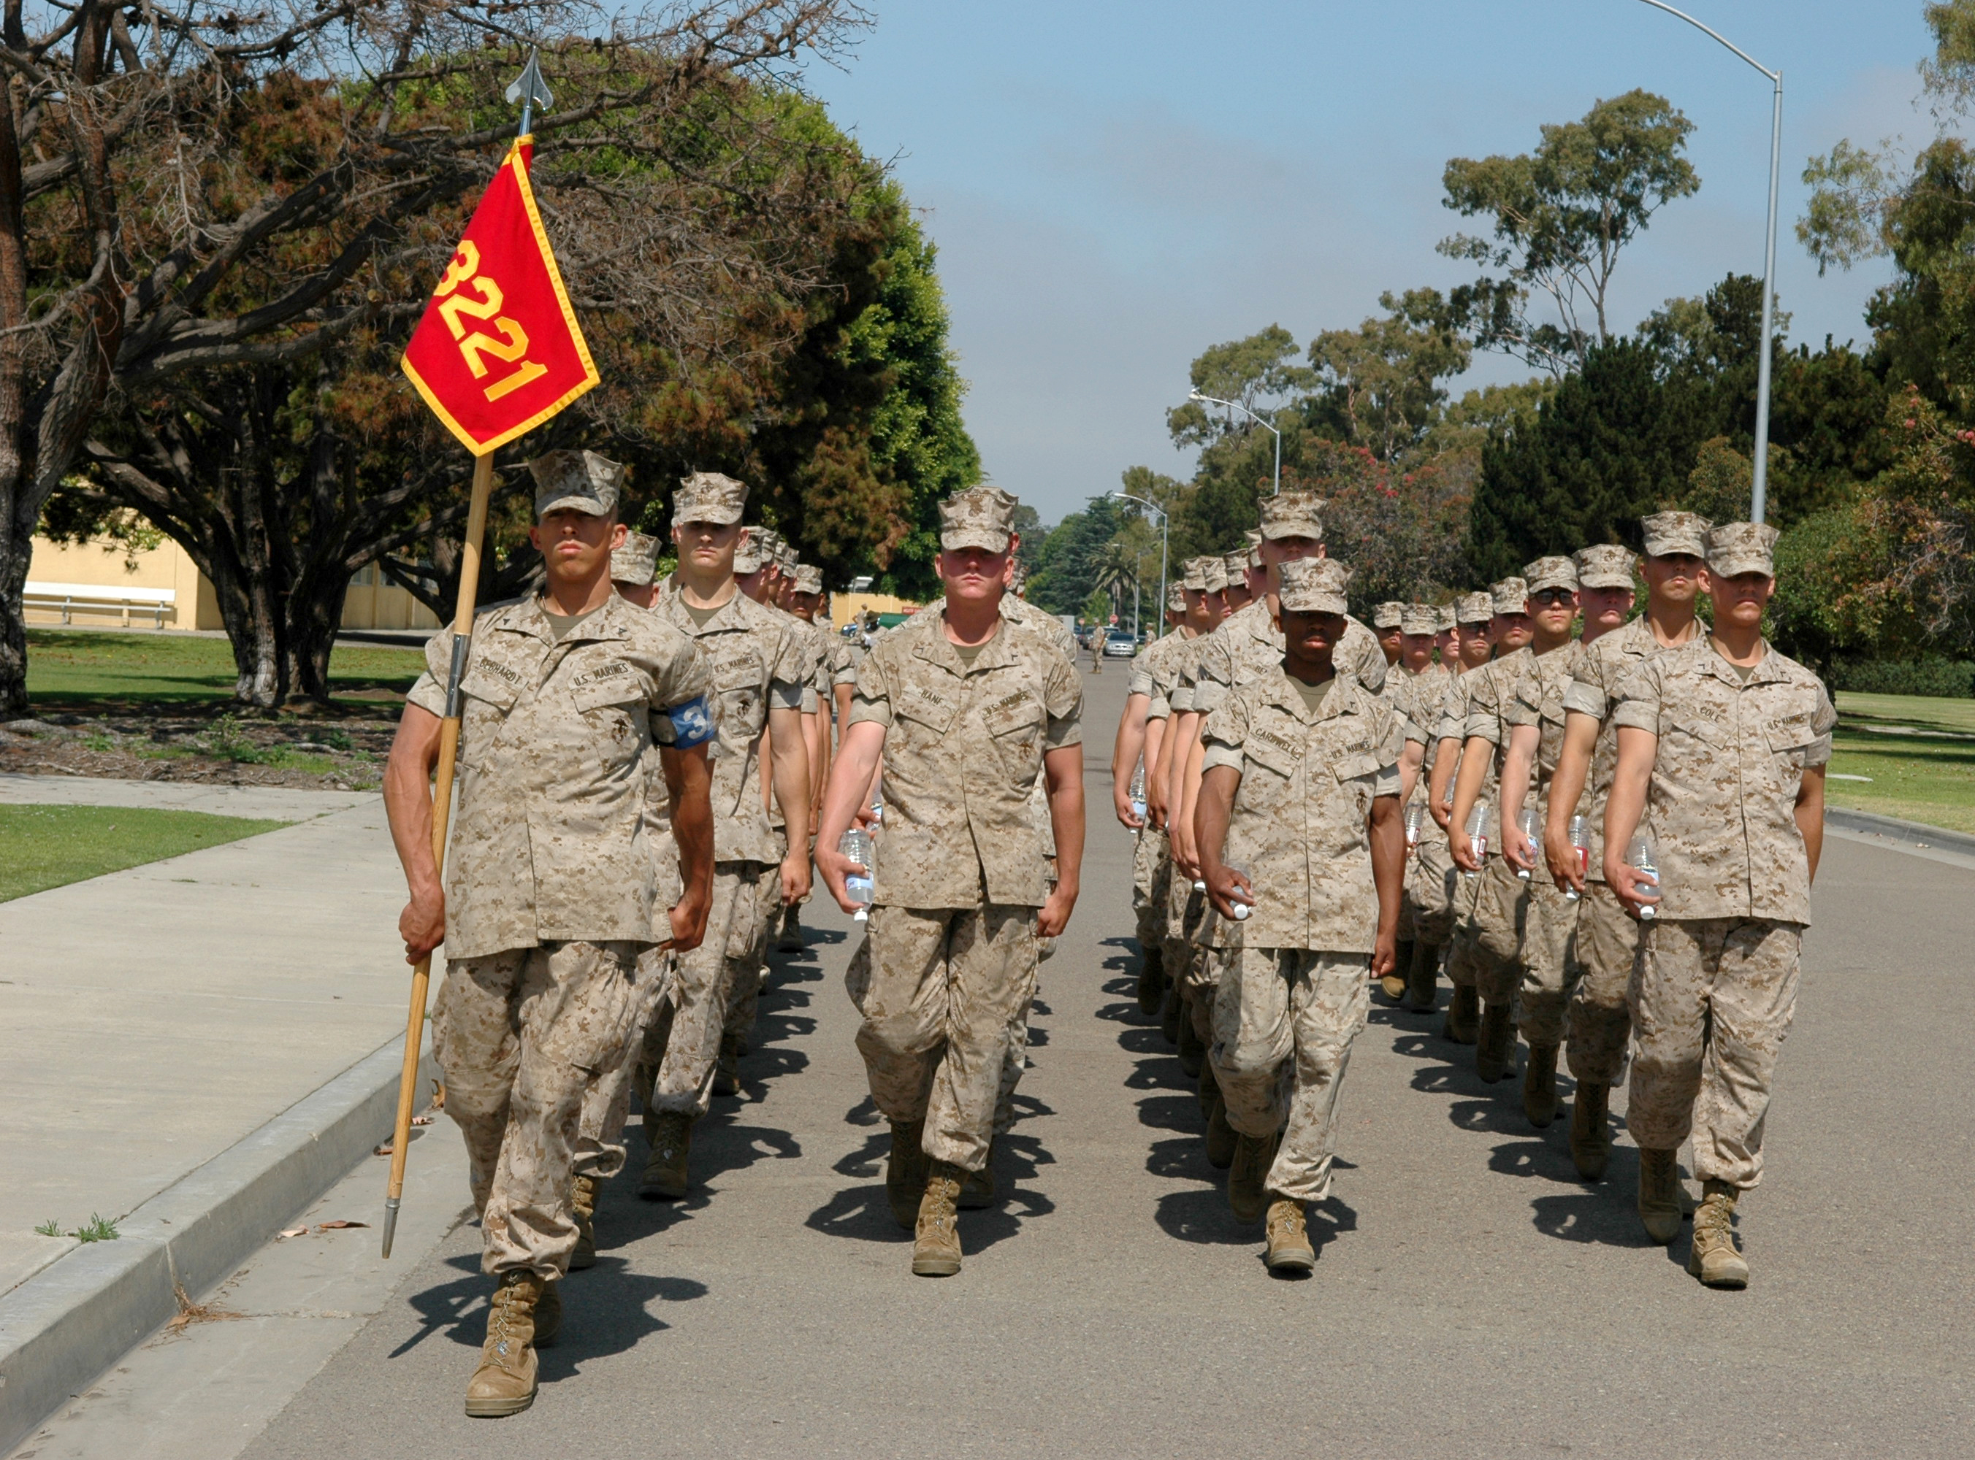
What is he?
He is the leader.

Slide 31
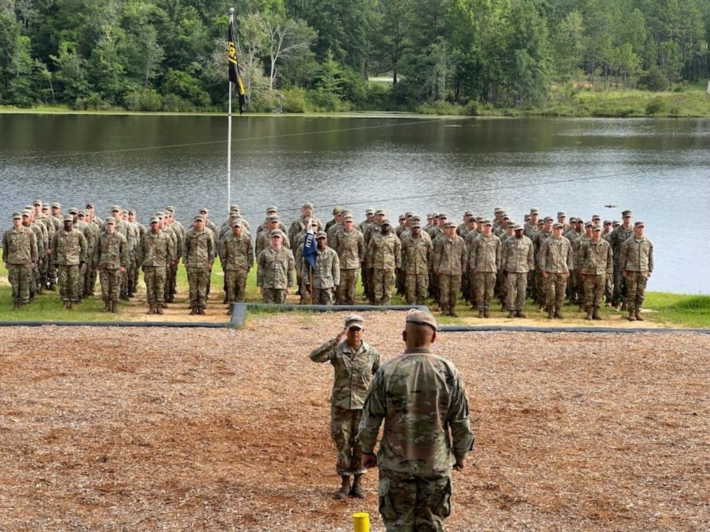
He is the leader.
Who is he?

Slide 32
He is Number 2.
Who is he?

Slide 33
He is Number 2.
Is he a leader?

Slide 35
C
L
EA
N
adj. 形容詞

Slide 36

It is clean.

Slide 37
C
L
EA
N
v. 動詞

Slide 38
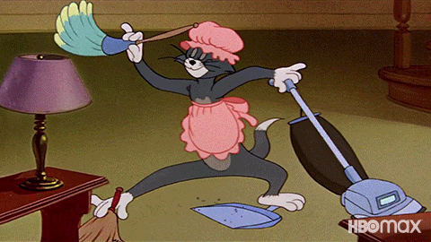
What does he do?
What is he doing?
He cleans.
He is cleaning.

Slide 39
C
L
EA
N
ER

Slide 40


Slide 42
It is
.
c
er
l
ea
n

Slide 43
ER
IR

Slide 44
D
IR
T
Y
adj. 形容詞

Slide 45


Slide 46

It is dirty!

Slide 47
CLEAN!

Slide 48

Get cleaner!

Slide 49
OK.

Slide 50
Clean the wall!

Slide 51
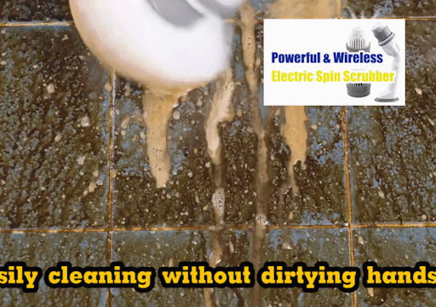
OK.

Slide 53
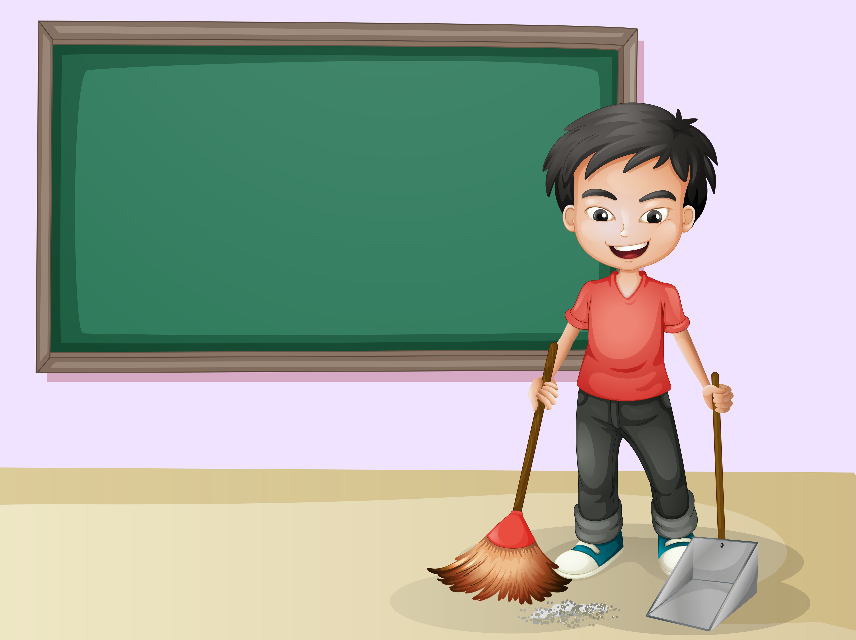
What does he do?
He sweeps.

Slide 54
What is he?
He is a sweeper.

Slide 55

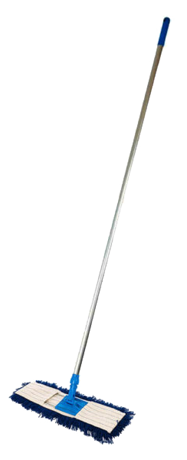
What does he do?
He mops.

Slide 56
What is he?
He is a mopper.

Slide 57
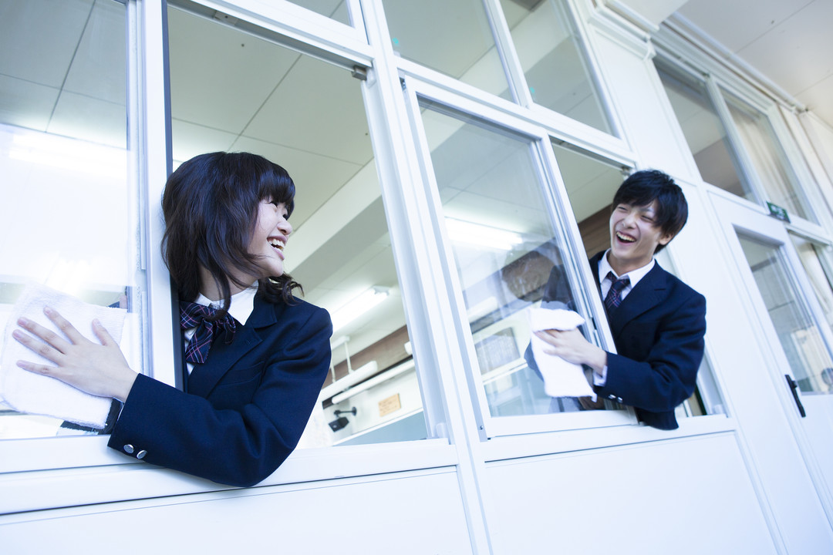
What are they?
They are window cleaners.

Slide 58
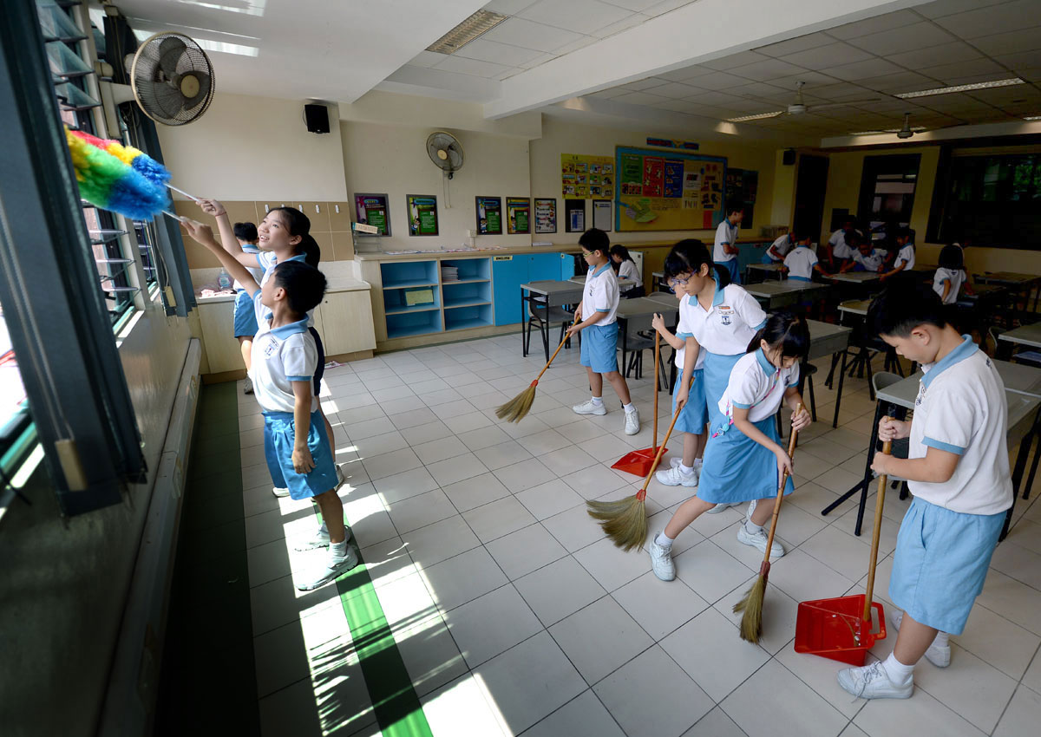

Who is he?

Slide 59
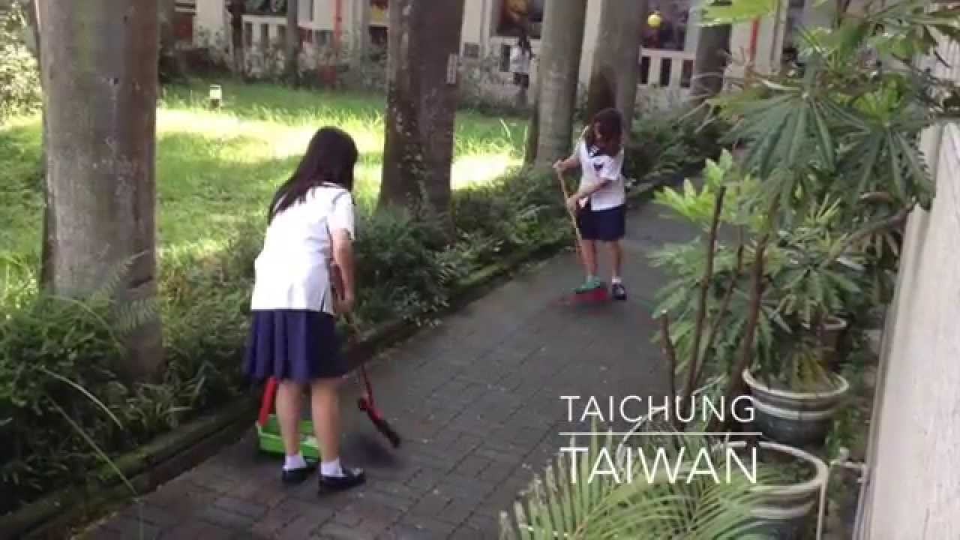
Who is he?

Slide 60
He is the outside cleaning leader.

Slide 61
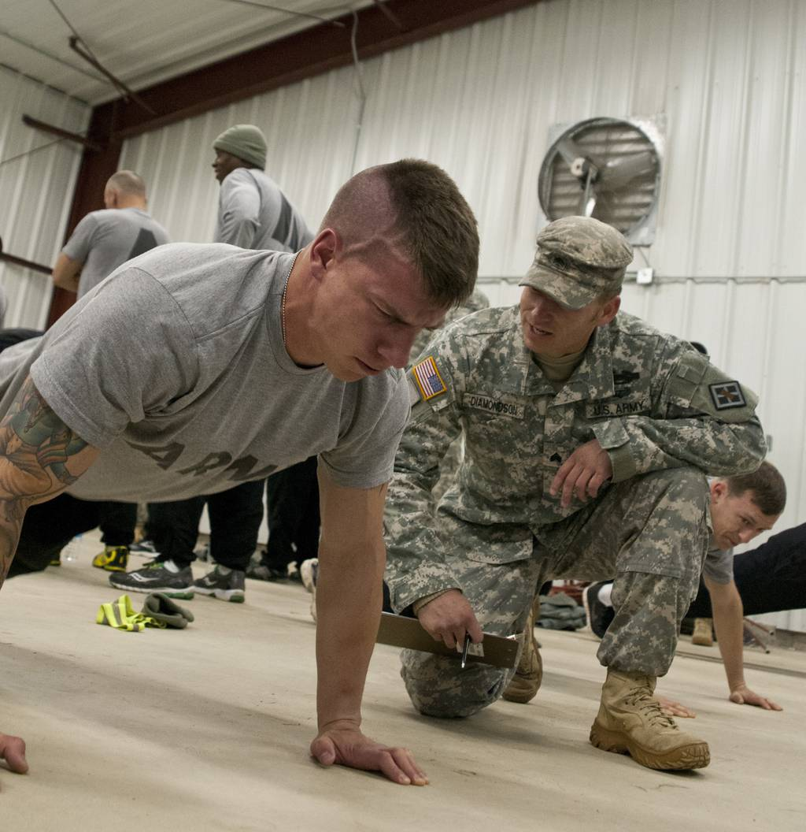
Who is he?

Slide 62
He is the P.E. leader.

Slide 63
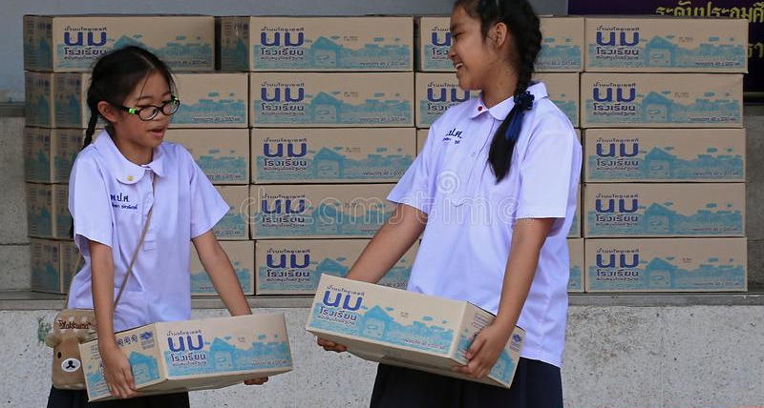
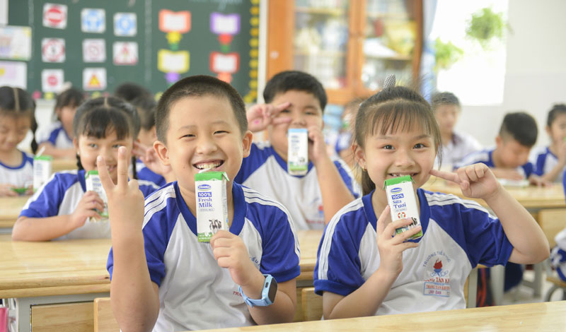
Who are they?

Slide 64
They are milk leaders.

Slide 65
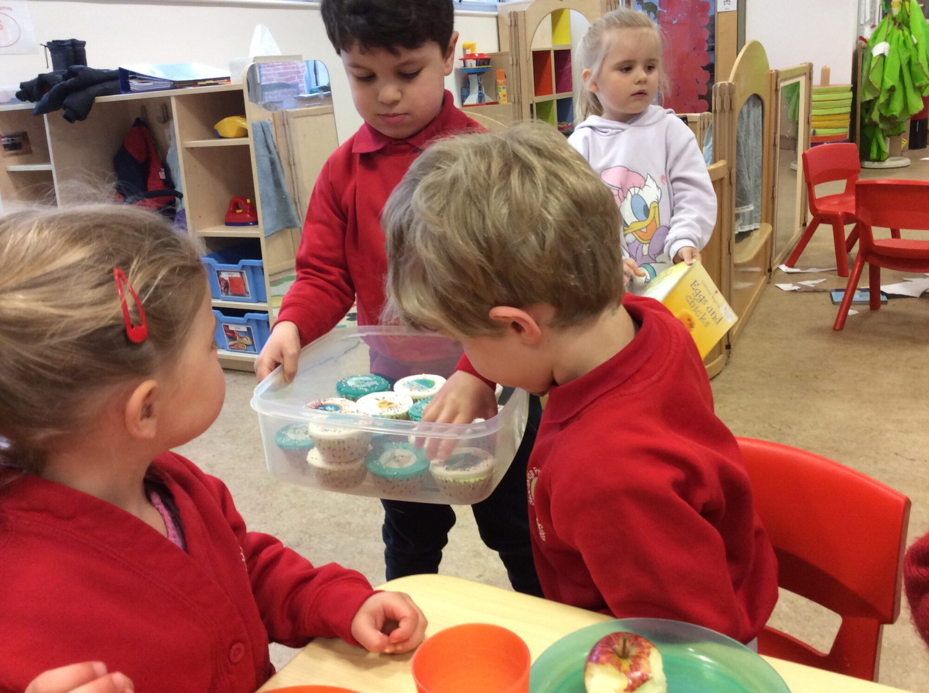
Who is he?

Slide 66
He is a snack time leader.

Slide 67
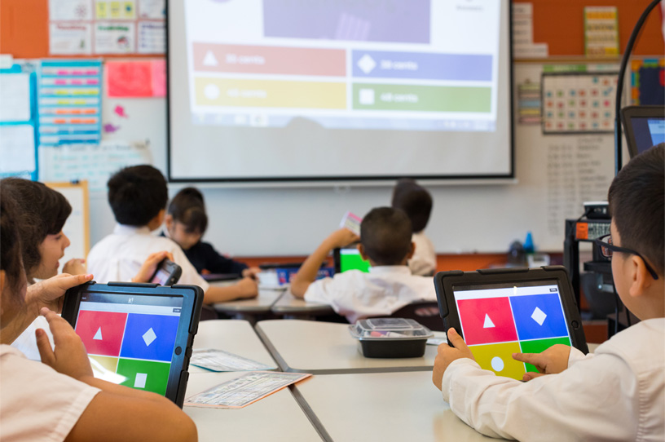

Slide 68
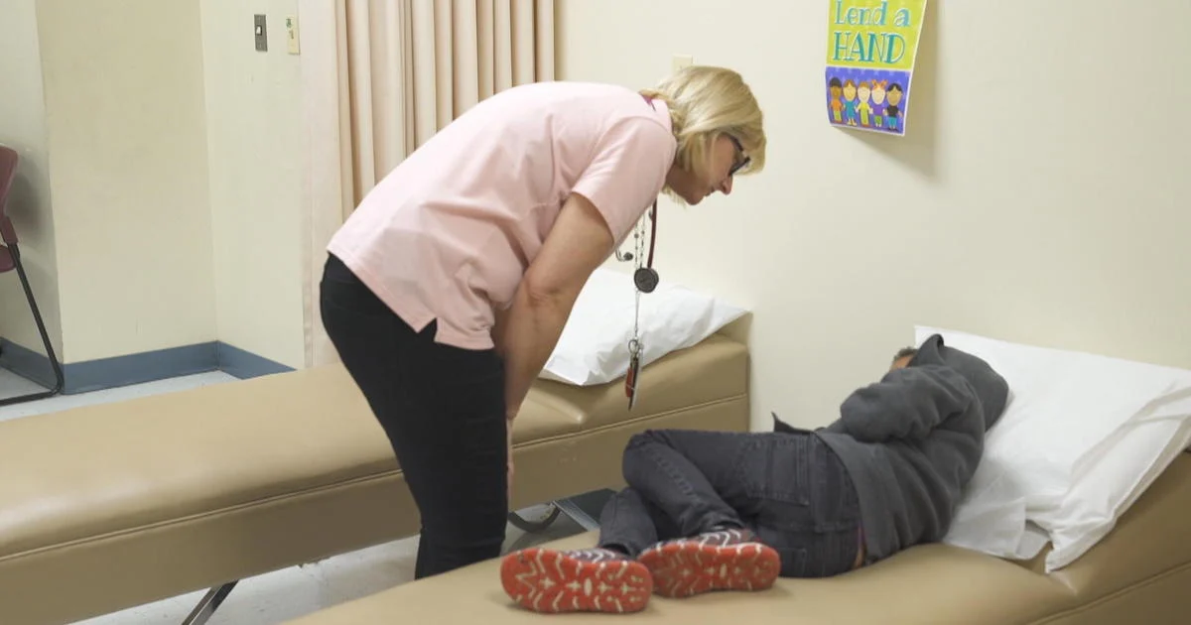

Slide 69


Slide 71
What is it?
It is a line.

Slide 72
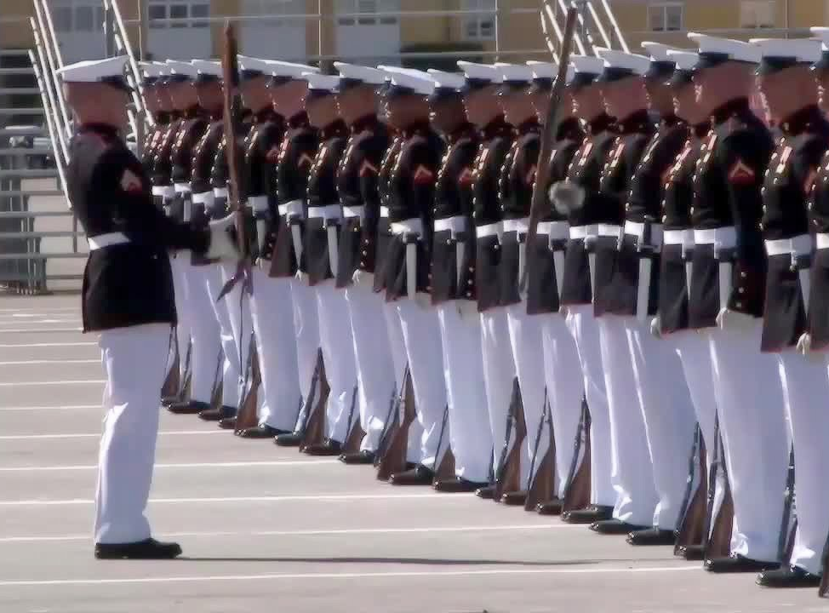
What is it?

Slide 73
It is a line.

Slide 74
What is he?
He is a line leader.

Slide 75
wh
i
ch
（用作疑問代名詞）哪一個，哪一些

Slide 76
What is he?
He is a line leader.

Slide 77
Which line?
Line 4.

Slide 78
He is the line 4 leader.

Slide 79
What is he?
He is a line leader.

Slide 80
Which line leader?
He is the line 3 leader.

Slide 81
inside
outside

